Slide 1


Spice and Savor
Team – Technozare
Members
Haolin Zhong
Robin Mathew
Yash Sacheshkumar Patel

Slide 2
Overview
The objective is to inspire and empower culinary enthusiasts with a diverse collection of easy-to-follow, delicious recipes that celebrate global flavors, promote healthy eating, and enjoy the joy of home cooking.
The website is dedicated to enhancing lives through the art and joy of cooking. Our food recipe blog is committed to sharing a wide array of delectable recipes that inspire home chefs to create delicious and nutritious meals.
Our mission extends beyond the kitchen, as we try to promote a healthier lifestyle and cultivate a sense of togetherness through the experience of preparing and enjoying wholesome meals.
The creators of the site wanted a place to share their love for food from their different backgrounds to the rest of the world.

Slide 3
GOAL
Provide a simple website for recipes from the popular three cuisines
Chinese Cuisine
Indian Cuisine
Mexican Cuisine
Provide simple to follow instructions for cooking various dishes and the required prep and cook times related to each dish.
Provide an intuitive and simple blog site for recipes so that any age demographic can navigate.
Save your favourite recipes for later.
Print out your recipes in a simple format to use on the go.
Provide a mobile friendly site for users to easily access recipes.

Slide 4
TARGET AUDIENCE
The major demographic that this website intends to target are food and culinary enthusiasts.
Basing our data on similar food recipe sites with huge internet traffic we can see that demographic that visit these sites mainly consists of:
65-70% Female and the rest male.
Highest age group is 25-34 forming 20-25% of visitors
Followed by an almost even split among 35-44, 45 -54 and 55-64 age groups forming 17-20% of visitors for each age group.
The other demographic that we target are food bloggers who wish to share their recipes with rest of the world.

Slide 5
SCOPE
Home Page
Provides a landing page for the users, that introduces to them the three major cuisines featured in the site via colourful images of food associated to each cuisine displayed in a carousel.
Provides an easy navigation to the recipe list of each cuisine through a click of the image in the carousel.
Display a short welcoming message to the visitors.
Recipe List Page
Provide a page for listing various available recipes of a cuisines via enticing images of the dish.
Provide a brief introduction/history of the cuisine.

Slide 6
SCOPE
Recipe Page
Provide easy to follow cooking instructions via a web page.
Provide sequenced instruction, with ingredients needed as well as total time needed to prepare the dish. This will provide a full view of the dish in front of them leading to better user satisfaction in completing their primary objective, i.e. getting the recipe for the dish.
Save the page to be easily viewed later via a “Save Recipe” button.
Save the recently visited recipes to be viewed later.
Provide a print button to print the recipe with minimal styling and option to include or exclude main images while printing.
Footer
Provide various methods of contact for the visitors.
Provide link to feedback form.

Slide 7
SCOPE
Recent & Saved Recipes Page
Provide a page to display and easily navigate to recently visited recipes.
Similarly, provide a page to display and easily navigate to recipes saved by the user on that device.
Feedback Form
Provide a page to send feedback on recipes as well as suggestions to the creators.
As of right now the values entered into the form are displayed in an output section (Since saving the feedback requires a backend which is out of scope of this project).
Navigation Bar
Provide easy and intuitive way to navigate to the 3 cuisine as well as to the ‘Recent & Saved recipes’ page.

Slide 8
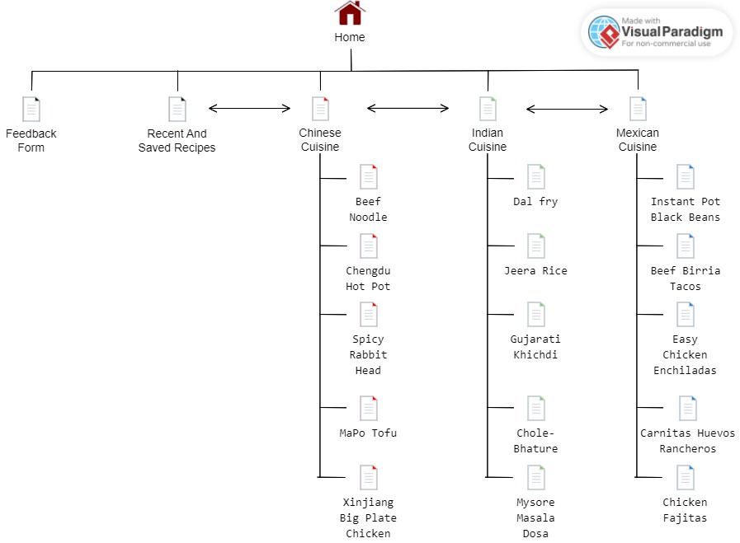
Design Related Resources (Sitemap)

Slide 9
Technical Specifications
Website uses a combination of web technologies to create a responsive and user-friendly platform:
HTML5 – Used for organizing web page contents.
CSS3 – Used for website styling, layout, carousel creation and print formatting to provide a simplistic and intuitive webpage.
JavaScript – To provide functionality to recent & saved recipes, carousel, form output, success messages and print/save buttons.
jQuery – To provide easier element selection and simplistic JavaScript code as well as hiding images based on user input while printing.
jQuery UI – To provide modal view to select the printing options such as print either with or without images.

Slide 10
Team Contributions
Haolin Zhong
Chinese Cuisine and Recipes HTML, Recipes pages styling, Save Button functionality.
Robin Mathew
Mexican Cuisine and Recipes HTML, Recipes list page styling, Navigation bar, Carousel, Recent & Saved Recipes, print formatting, mobile responsiveness.
Yash Sacheshkumar Patel
Indian Cuisine and Recipes HTML, Home page styling, Footer creation and styling, Feedback form, clear history.

Slide 11
Thank You
And Enjoy the Dishes

